Slide 1
Amazon Sales Analysis Project Report
Insights from Amazon Sales Data

Slide 2
INTRODUCTION
Objective: The primary aim of this report is to examine Amazon's sales data to derive insights into sales patterns, customer behavior, and product performance.
Scope: This analysis will encompass key metrics such as revenue from sales, categorization of products, demographics of customers, and seasonal sales fluctuations.
Context: Amazon, a prominent global e-commerce platform, is renowned for its extensive product range and worldwide presence. By analyzing its sales data, valuable insights can be gained to enhance marketing strategies and boost overall sales efficiency.

Slide 3
CONTINUOUS VARIABLE DISTRIBUTION
Unit Price: The majority of unit prices are around $180, as indicated by the median value. The maximum unit price is approximately $668.27, with no outliers visible in the box plot.
Unit Cost: Most unit costs are around $107, according to the median value. The box plot also indicates that there are no outliers, with the maximum unit cost being around $525.
Total Revenue: The majority of total revenue generated is below $750,000, as seen from the median value and the highest bar in the histogram. However, the box plot reveals three outliers on the higher end, with a maximum value around $6,000,000.
Total Cost: Most total costs are below $360,000, as indicated by the median value and the highest bar in the histogram. Similar to total revenue, the box plot shows three outliers on the higher side, with a maximum value around $4,500,000.

Slide 4
Total Profit: Profit, calculated as the difference between total revenue and total cost, shows that most values are around $290,768, as indicated by the median. The box plot reveals more than three outliers in this column, with a maximum value of $1.7 million, which is significantly higher than the average total revenue.
Unit Profit: Unit profit, calculated as the difference between unit price and unit cost, shows that most values are around $74, as indicated by the median. The box plot indicates no outliers, with the maximum unit profit being approximately $174.
Units Sold: The majority of units sold are around 5,383, as indicated by the median value. The box plot shows no outliers, with the maximum units sold being 9,925 and the minimum being 124.
Shipping Duration: Most shipping durations are within 24 days, as indicated by the median value. The data shows a low deviation or spread, with no outliers. The maximum shipping duration is 50 days, and the minimum is 0 days.

Slide 5
The most common regions are Sub-Sahara Africa (37) and Europe (24).
Most of the shipping is happening on Saturday and Wednesday and least on Sunday.
Most of the entries are of year 2012 and 2015.
Most of the entries are of month Feb, Jul, May, Oct.
CATEGORICAL VARIABLE DISTRIBUTION
TIME BASED CATEGORICAL DISTRIBUTION
MONTHLY SALES TREND
YEARLY SALES TREND

Slide 6
INSIGNTS FROM UNIVARIATE ANALYSIS
Unit Price: The median unit price is approximately $180. The highest unit price observed is $668.27, and no significant outliers are present according to the box plot.
Unit Cost: The median unit cost is around $107. Similar to the unit price, there are no outliers, and the maximum unit cost recorded is about $525, as indicated by the box plot.
Total Profit: The majority of total profit values fall around $290,000, as shown by the median value. The box plot reveals more than three outliers in this category, with the highest value reaching approximately $1.7 million, which is significantly higher than the average total revenue.
Units Sold: Most units sold are within the range of 5,383 units, as determined by the median value. The box plot shows no outliers in this category, with a maximum of 9,925 units sold and a minimum of 124 units.

Slide 7
Shipping Duration: Most shipping durations are within 24 days, as indicated by the median and low data spread. There are no significant outliers, with the maximum and minimum durations being 50 and 0 days, respectively.
Sales Channel: Both offline and online sales channels are used equally, with a 50-50 distribution.
Item Type: The majority of items are categorized as Clothes, Cosmetics, and Office Supplies.
Region: The most common regions for sales are Sub-Saharan Africa (37 entries) and Europe (24 entries).Country: Most countries have only one entry, covering 83% of the dataset.
Shipping Day: The majority of shipments occur on Saturdays and Wednesdays, with Sundays being the least common.
Month: The most frequent entries are from February, July, May, and October, with a general decline in entries afterward.
Year: Most entries are from the year 2012, and there is a noticeable decrease in entries in subsequent years.

Slide 8
BIVARIATE ANALYSIS
To identify sales trends, we need to analyze them on a monthly, yearly, and year-over-month basis.
We can explore the relationship of these trends with continuous variables, such as:
Total Profit
Units Sold
Additionally, we can examine the relationship between item types and:
Unit Profit
Units Sold

Slide 9
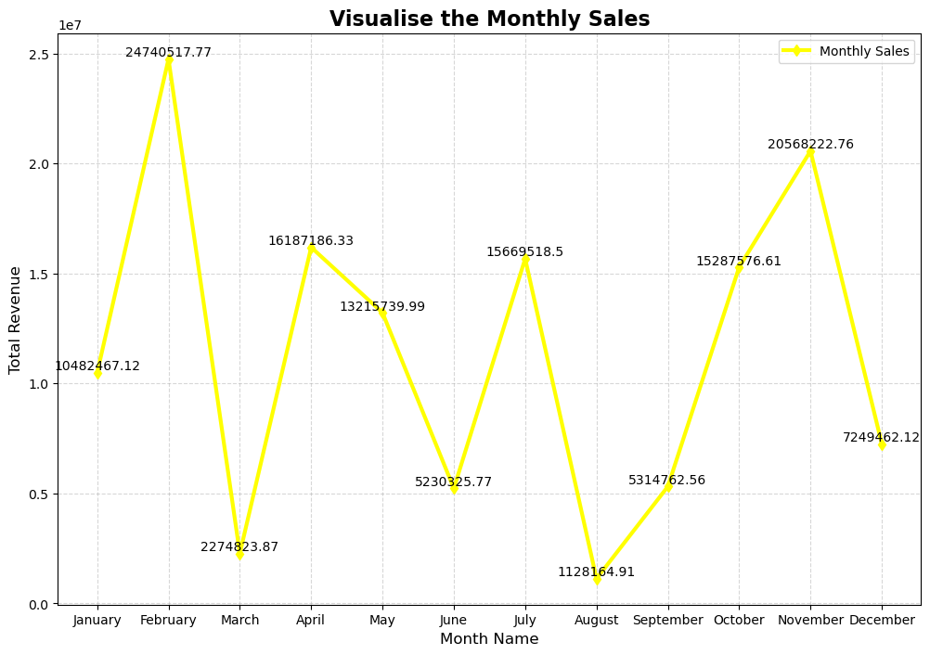
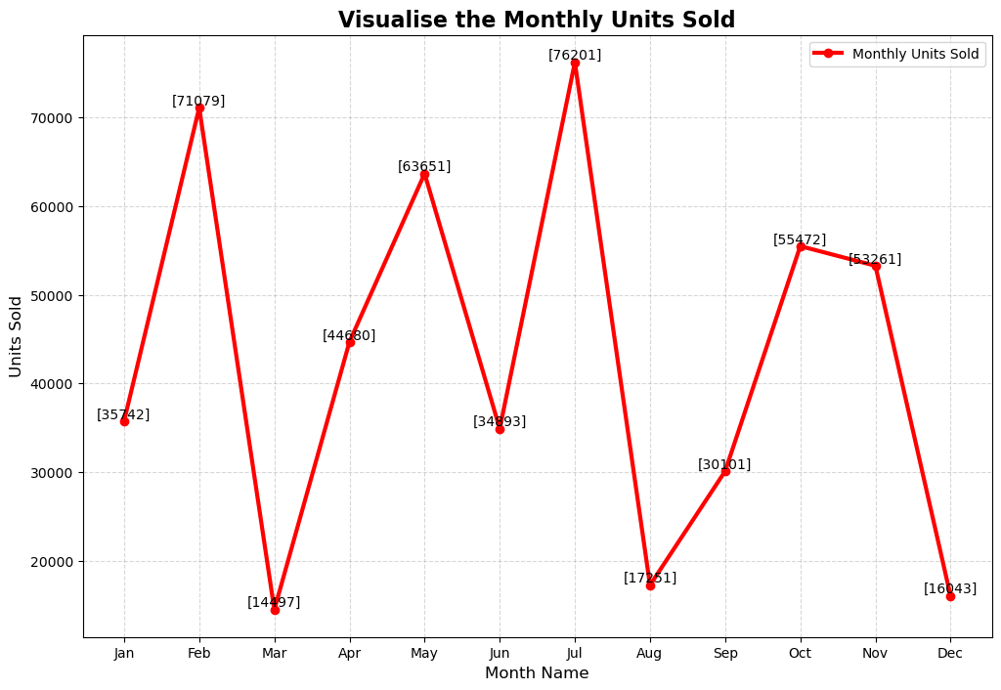
MONTH-WISE SALES
Monthly Revenue
Monthly Units Sold
INSIGHTS:
Highest profit made in month February (approx. $24.5M) and November (approx. $20.3M) and minimum in August (approx. $1.2M) and March (approx. $2.3M)
Highest units sold are in July (76.2k) followed by February(71k), and least in August(14.5k), March(17.2k) and December(16k).

Slide 10
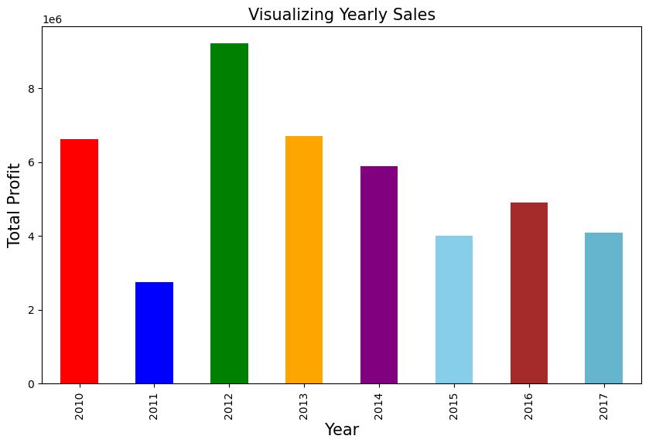
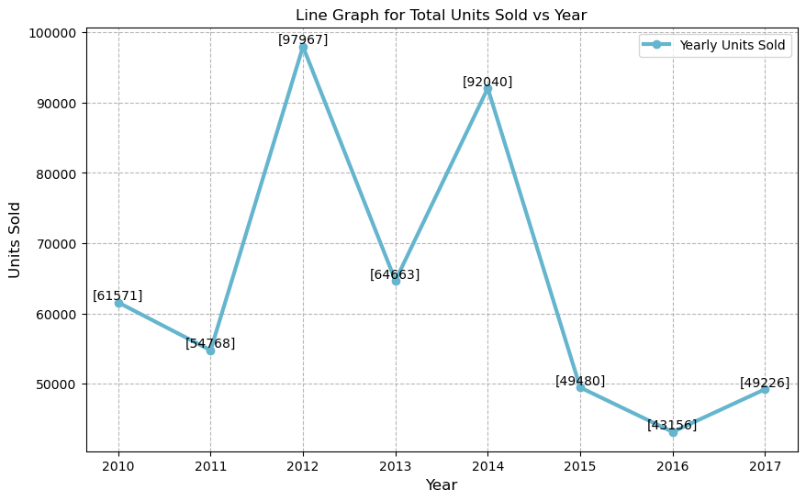
YEARLY SALES
Yearly Revenue
Yearly Units Sold
INSIGHTS:
Maximum Profit is in year 2012 and minimum in 2011.
We can see two peaks one at year 2012 and next at 2014. They are max unit sold in year.

Slide 11
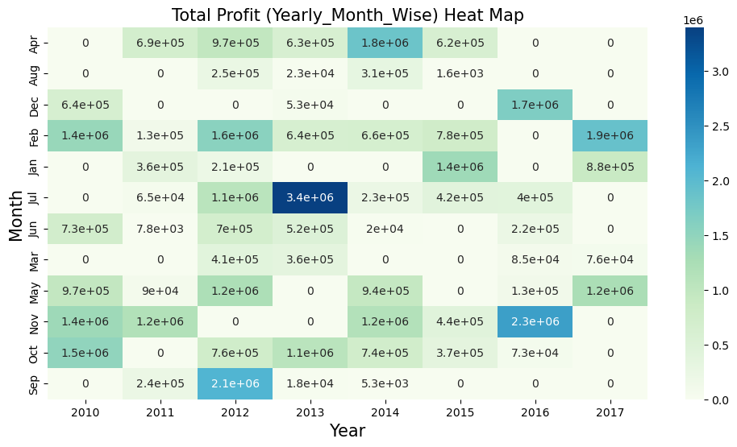
YEARLY-MONTH-WISE SALES AND PROFIT
About heat map between year-month and profit represents the profit in particular month of particular year (for example January 2012 profited an amount of $3.4M).

Slide 12
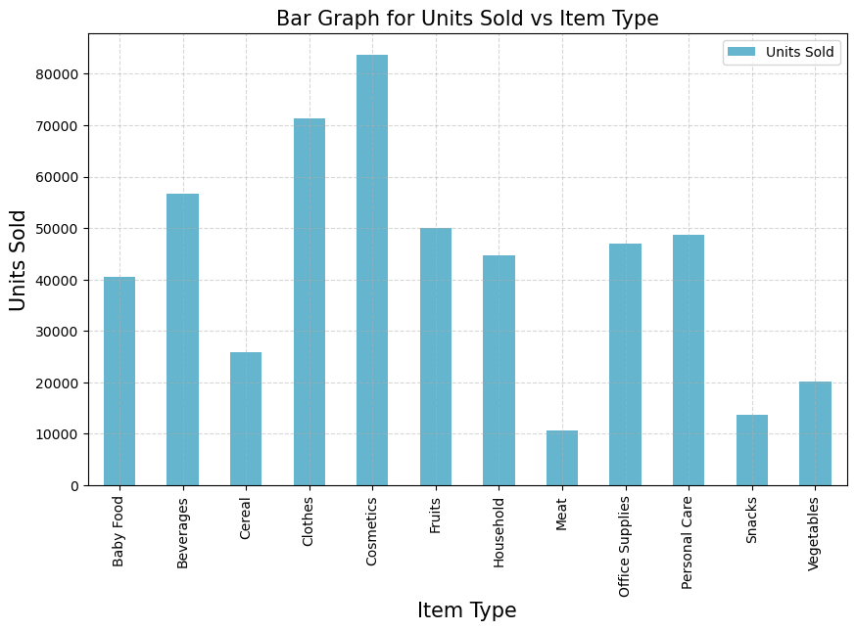
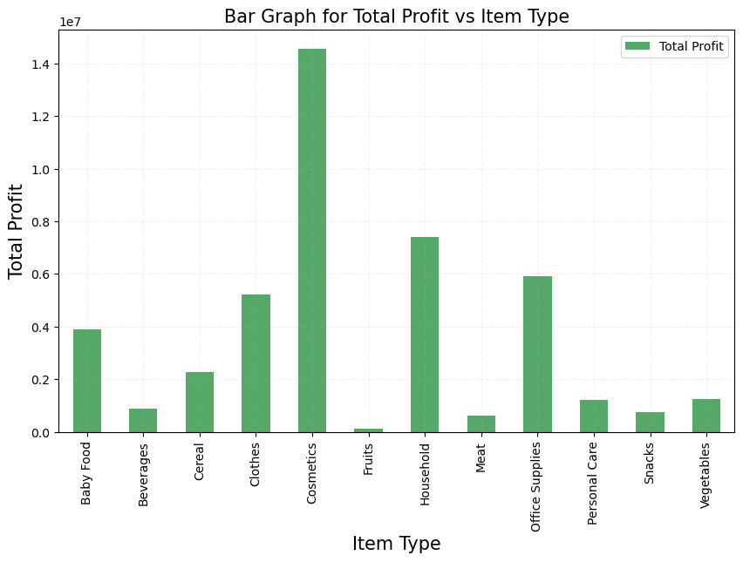
ITEM-WISE SALES AND PROFIT
Above graphs shows that most items sold are from “Cosmetics” and “Clothes” in left one on the other hand most profitable items includes “Cosmetics” and “Households”

Slide 13
FINAL RESULTS FROM EDA
Unit Price: The majority of unit prices are around $180, as indicated by the median value. The maximum observed unit price is $668.27, with no outliers, as shown in the box plot.
Unit Cost: The median unit cost is approximately $107. The box plot confirms there are no outliers, with the highest unit cost being about $525.
Total Profit: The majority of total profit values are around $290,000, as indicated by the median value.
Profit Over Time: The box plot reveals more than three outliers, with the highest total profits occurring in February and November, and the lowest in March and August. Total profit peaked in 2012 and dropped in 2011. Maximum profit is generated from cosmetics, while minimum profit comes from food items like fruits, beverages, and meat.
Units Sold: Most units sold range within 5383 units, with no outliers observed in the box plot. The maximum units sold are 9925, and the minimum is 124.

Slide 14
Highest Units Sold: July had the highest sales, followed by February. December had the least sales.
Peak Sales Years: The maximum units were sold in 2012, followed by 2014.Top-Selling Categories: Clothes and cosmetics had the highest sales, while meat had the lowest.
Shipping Duration: Most shipments were completed within 24 days, with no significant outliers. The maximum and minimum shipping times were 50 and 0 days, respectively.
Popular Item Types: The most common items sold were clothes, cosmetics, and office supplies.
Top Regions: Sub-Saharan Africa and Europe were the most common shipping destinations.
Shipping Days: Most shipments occurred on Saturdays and Wednesdays, with the least on Sundays.

Slide 15
CONCLUSION
Summary of Findings: The analysis of Amazon’s sales data revealed key insights into sales trends, customer preferences, and product performance. Notable findings include the top-selling product categories, peak sales periods, and customer demographics.
Recommendations: Based on these findings, it is recommended to focus marketing efforts on high-performing product categories, tailor promotions to specific customer segments, and optimize inventory management during peak sales periods.
Future Work: Future research could explore the impact of external factors like economic conditions on sales, conduct A/B testing for marketing strategies, and analyze customer feedback to enhance the overall shopping experience.

